Slide 1
Aneuvis figures

Slide 2
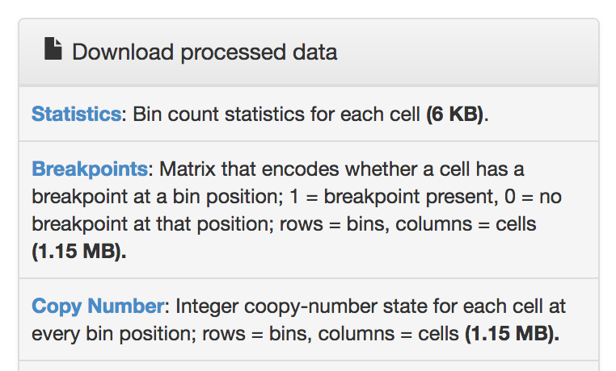
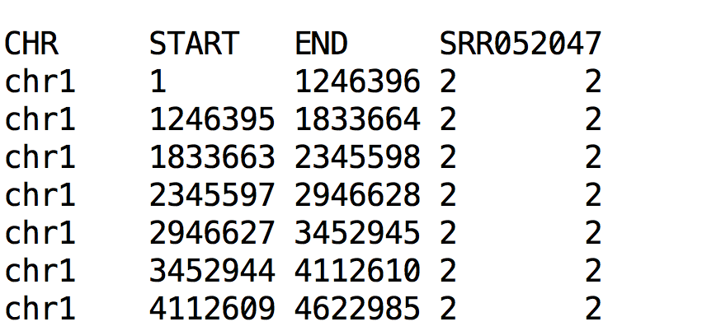
Screenshot from ginkgo website
These 3 columns are coordinates: the chromosome (CHR) plus the START and END position of each coordinate
1st row is the column names
http://qb.cshl.edu/ginkgo/?q=results/_t10breast_navin
Tab-separated file (.txt, .tsv)

Slide 3
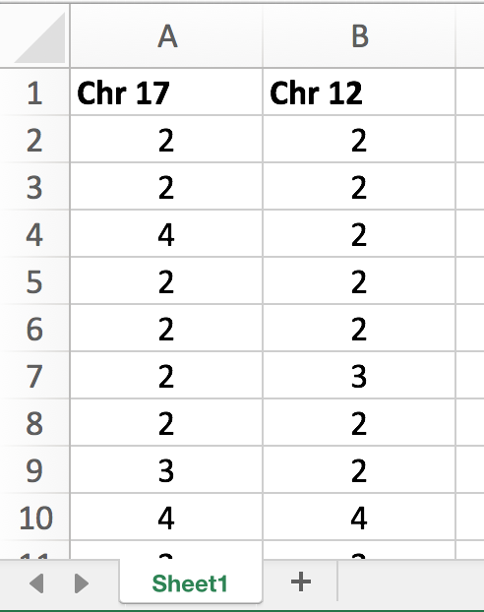
Each column is a chromosome (up to 4 columns)
First row is the name of each chromosome
Each row represents the number of chromosomes in an individual cell
Any name
.xls or .xlsx file

Slide 4
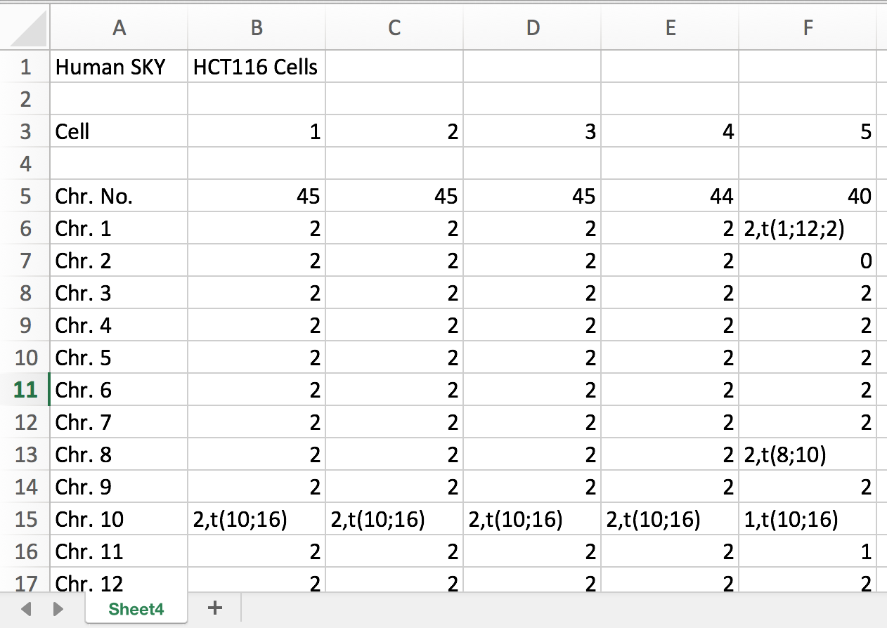
First column is the chromosome name
Each column is a cell
First row is the name of each chromosome
Optional header
Each row is a chromosome
Any name
.xls or .xlsx file
https://cgap.nci.nih.gov/Chromosomes/ISCNSymbols

Slide 5
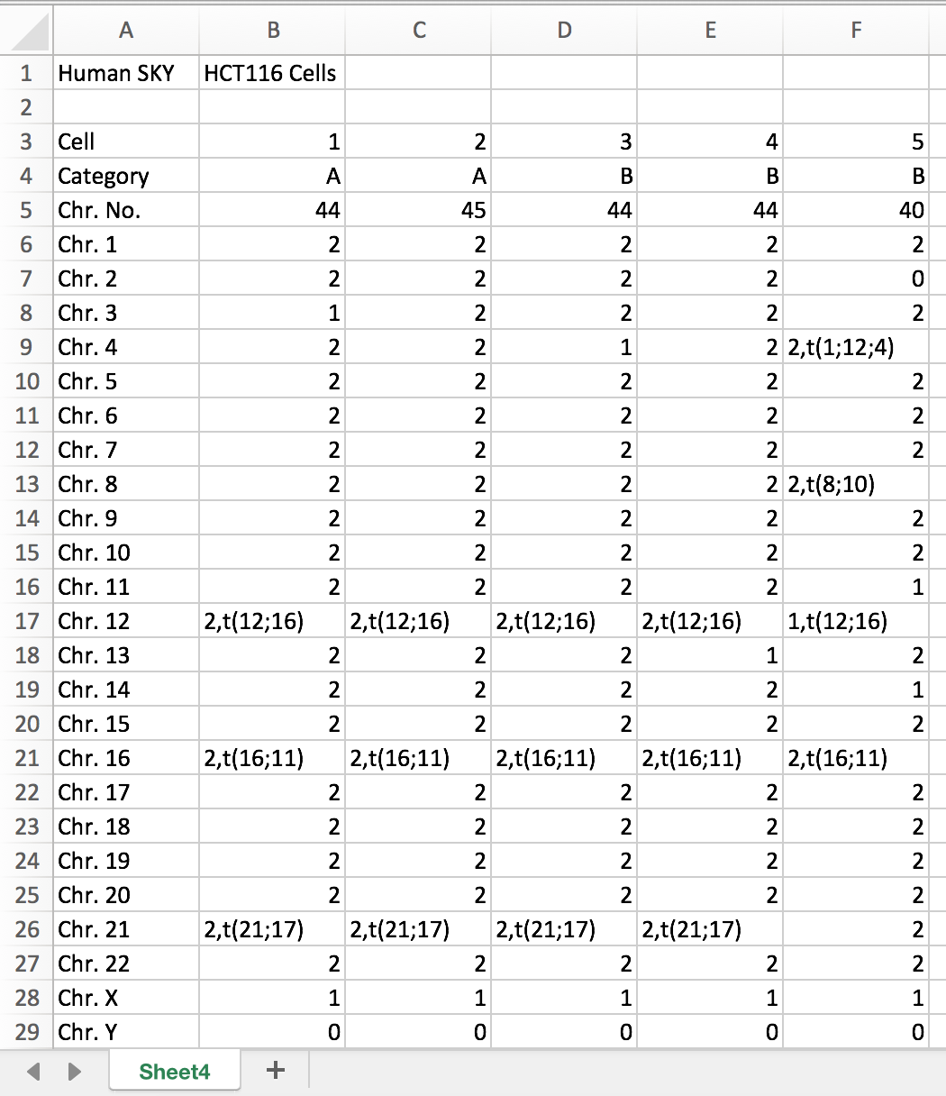
First column is the chromosome name.*
*All labels in the first column should match what is shown here
Each column is a cell
Optional header
Cell number (1, 2, …, n)
Category – indicates different patients
# of chromosomes (optional)
Integer indicating # of chromosomes
Each row is a chromosome
ISCN symbols are accepted
Any name
.xls or .xlsx file
https://cgap.nci.nih.gov/Chromosomes/ISCNSymbols

Slide 6
These 3 columns are coordinates: the chromosome (CHR) plus the START and END position of each coordinate
Each subsequent column is an individual cell.
1st row contains column names. SRR052047 is the ID of 1 single cell
Each row is a chromosomal bin
Tab-separated file (.txt, .tsv)
Number of copies at 1 bin in 1 cell

Slide 7
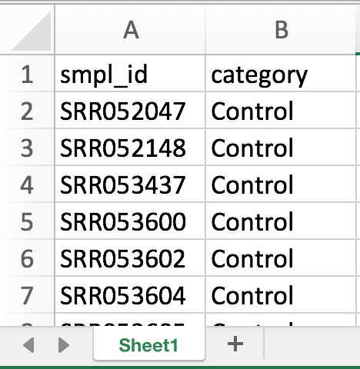
*Sample identifier
*Should match column names in copy number file
category
Column headers (should be named as shown here)
Each row corresponds to 1 sample

Slide 8
Input
Copy number matrices
.bed
Display
File type
Cells
Summary
Heatmaps
Table
Inference
- Cross-platform
- Cross-label
.xls, .xlsx
Aneuvis
Chromosomes
Cells
Chromosomes
FISH
SKY, SC-WGS
Description
Visualization
Table summary
Inference
Comparison
- Cross-platform
-
Aneufinder
Ginkgo
Fluorescent labeling and counting
Treatment labels
.bam files
Visualization
Table summary
Experiment
Control vs Treatment A

Slide 9
Input
a
Copy number matrices
.bed
Display
Cells
Summary
Copy number heatmaps
Measures of chromosome number variation (Table)
Statistical Inference
- Between experimental platforms
- Between treatments
.xls, .xlsx
Aneuvis
Chromosomes
Cells
Chromosomes
FISH
SKY, SC-WGS
Aneufinder
Ginkgo
Fluorescent labeling and counting
Treatment labels
.bam files
Experiment
Control vs Treatment A
b

Slide 10
Control vs Treatment A vs Treatment B
Patient A vs Patient B
Patient A vs Patient B
Between-group summary
Input
a
Copy number matrices
.bed
Display
Cells
Treatment-level summary
Copy number heatmaps
Measures of chromosome number variation (Table)
Statistical Inference
- Between experimental platforms
- Between treatments
.xls, .xlsx
Aneuvis
Chromosomes
Cells
Chromosomes
FISH
SKY, SC-WGS
Existing software
Treatment labels
Treatment B
Treatment A
Experiment
b
Control
Question: Do treatments A and B induce aneuploidy/CIN?

Slide 11

Question: Do treatments A and B induce aneuploidy/CIN?
a
Treatment B
.xls, .xlsx
.bed
Display
Chromosomes
Cells
Treatment A
Control
Experiment
Cells
Chromosomes
FISH
SKY, SC-WGS
FISH, SKY, SC-WGS
Experimental groups
Copy number matrices
Aneuvis
a
Input
User-friendly, interactive, open-source web application
Output
FISH
SKY
SC-WGS
Upload data and provide experimental labels
Gridplot
Treatment labels
Can we see any patterns?
Ternary plot
Chr. x Cell
Heatmap
Are there statistically significant differences between groups?
Summary tables
Treatment-level summary
Copy number heatmaps
Measures of chromosome number variation (Table)
Statistical Inference
- Between experimental platforms
- Between treatments
Permutation tests
Is there statistical significance?
Visualize
Summarize
Between treatments and experimental platforms

Slide 12


Question: Do treatments A and B induce aneuploidy/CIN?
a
b
Treatment B
.xls, .xlsx
.bed
Chromosomes
Cells
Treatment A
Experiment
Control
Cells
Chromosomes
FISH, SKY, SC-WGS
Experimental groups
Copy number matrices
c
Aneuvis summarizes numerical chromosomal changes between experimental groups.
FISH bivariate %-age heatmap
Copy number heatmap
Summary statistics
chromosomes
Cell state
Loss
User uploads copy number matrices and experimental groups.
Aneuvis automatically constructs summary statistics and visualizations
Gain
Upload
# chromosomes
chromosome
Score scatterplot
Ternary plot
Group (& Chromosome)
% diploid
Analysis
Aneuploidy
% aneu-ploid
% poly-ploid
Heterogeneity
Permutation
Notes:
is an interactive, open-source web application for summarizing
A single place for interactive analysis of chromosomal changes between groups

Slide 13
Question: Do treatments A and B induce aneuploidy/CIN?
a
b
Treatment B
.xls, .xlsx
.bed
Chromosomes
Cells
Treatment A
Experiment
Control
Cells
Chromosomes
FISH, SKY, SC-WGS
Experimental groups
Copy number matrices
c
Aneuvis summarizes numerical chromosomal changes between experimental groups.
FISH bivariate %-age heatmap
Copy number heatmap
User uploads copy number matrices and experimental groups
Summary statistics
chromosomes
Cell state
Loss
Gain
Upload
# chromosomes
chromosome
Automatic calculation of summary statistics and visualizations
Score scatterplot
Ternary plot
Group (& Chromosome)
% diploid
Analysis
Aneuploidy
Permutation tests check for significant differences between groups
% aneu-ploid
% poly-ploid
Heterogeneity
Permutation
Notes:
is an interactive, open-source web application for summarizing
A single place for interactive analysis of chromosomal changes between groups

Slide 14
Polyploidization rate

Slide 15
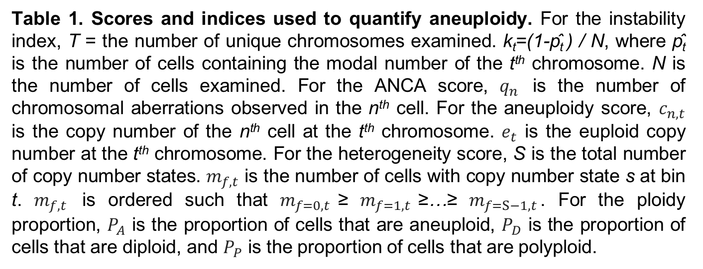
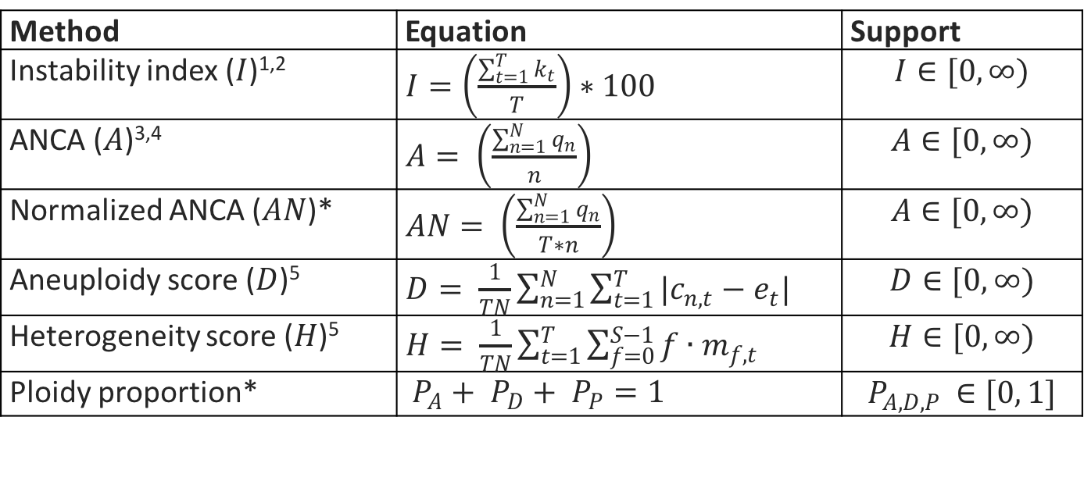
Method | Equation | Support
Instability index ($I$)^{1,2} | $I=\left(\frac{\sum_{t=1}^{T}{k_{t}}}{T}\right)∗100$ | $$I∈[0, ∞)$$
ANCA ($A$)^{3,4} | $A= \left(\frac{\sum_{n=1}^{N}{q_{n}}}{n}\right)$ | $$A∈[0, ∞)$$
Normalized ANCA ($AN$)* | $AN= \left(\frac{\sum_{n=1}^{N}{q_{n}}}{T∗n}\right)$ | $$A∈[0, ∞)$$
Aneuploidy score ($D$)⁵ | $D= \frac{1}{TN}\sum_{n=1}^{N}{\sum_{t=1}^{T}{{|c}_{n,t}−e_{t}|}}$ | $$D∈[0, ∞)$$
Heterogeneity score ($H$)⁵ | $H= \frac{1}{TN}\sum_{t=1}^{T}{\sum_{f=0}^{S−1}{{f∙m}_{f,t}}}$ | $$H∈[0, ∞)$$
Ploidy proportion* | $P_{A}+ P_{D}+ P_{P}=1$ | $$P_{A,D,P }∈[0, 1]$$
Table 1. Scores and indices used to quantify aneuploidy. For the instability index, T = the number of unique chromosomes examined. k_{t}=(1-p̂_{t} ) / N, where p̂_{t} is the number of cells containing the modal number of the t^{th} chromosome. N is the number of cells examined. For the ANCA score, $q_{n}$ is the number of chromosomal aberrations observed in the n^{th} cell. For the aneuploidy score, $c_{n,t}$ is the copy number of the n^{th} cell at the t^{th} chromosome. $e_{t}$ is the euploid copy number at the t^{th} chromosome. For the heterogeneity score, S is the total number of copy number states. $m_{f,t}$ is the number of cells with copy number state s at bin t. $m_{f,t}$ is ordered such that $m_{f=0,t}$≥ $m_{f=1,t}$≥…≥ $m_{f=S−1,t}$. For the ploidy proportion, $P_{A}$ is the proportion of cells that are aneuploid, $P_{D}$ is the proportion of cells that are diploid, and $P_{P}$ is the proportion of cells that are polyploid.

Slide 16
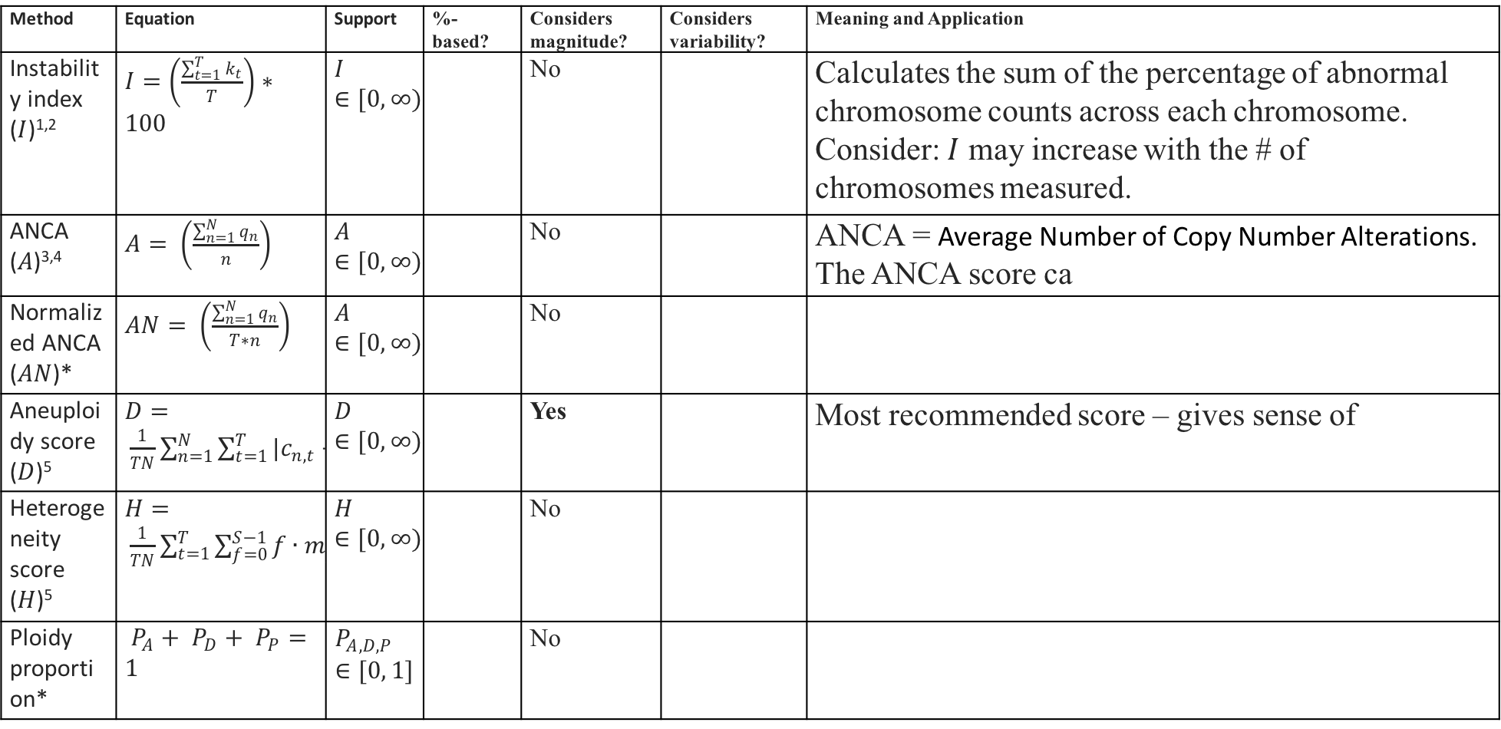
Method | Equation | Support | %-based? | Considers magnitude? | Considers variability? | Meaning and Application
Instability index ($I$)^{1,2} | $I=\left(\frac{\sum_{t=1}^{T}{k_{t}}}{T}\right)∗100$ | $$I∈[0, ∞)$$ |  | No |  | Calculates the sum of the percentage of abnormal chromosome counts across each chromosome. Consider: $I$ may increase with the # of chromosomes measured.
ANCA ($A$)^{3,4} | $A= \left(\frac{\sum_{n=1}^{N}{q_{n}}}{n}\right)$ | $$A∈[0, ∞)$$ |  | No |  | ANCA = Average Number of Copy Number Alterations. The ANCA score ca
Normalized ANCA ($AN$)* | $AN= \left(\frac{\sum_{n=1}^{N}{q_{n}}}{T∗n}\right)$ | $$A∈[0, ∞)$$ |  | No
Aneuploidy score ($D$)⁵ | $D= \frac{1}{TN}\sum_{n=1}^{N}{\sum_{t=1}^{T}{{|c}_{n,t}−e_{t}|}}$ | $$D∈[0, ∞)$$ |  | Yes |  | Most recommended score – gives sense of
Heterogeneity score ($H$)⁵ | $H= \frac{1}{TN}\sum_{t=1}^{T}{\sum_{f=0}^{S−1}{{f∙m}_{f,t}}}$ | $$H∈[0, ∞)$$ |  | No
Ploidy proportion* | $P_{A}+ P_{D}+ P_{P}=1$ | $$P_{A,D,P }∈[0, 1]$$ |  | No

Slide 17
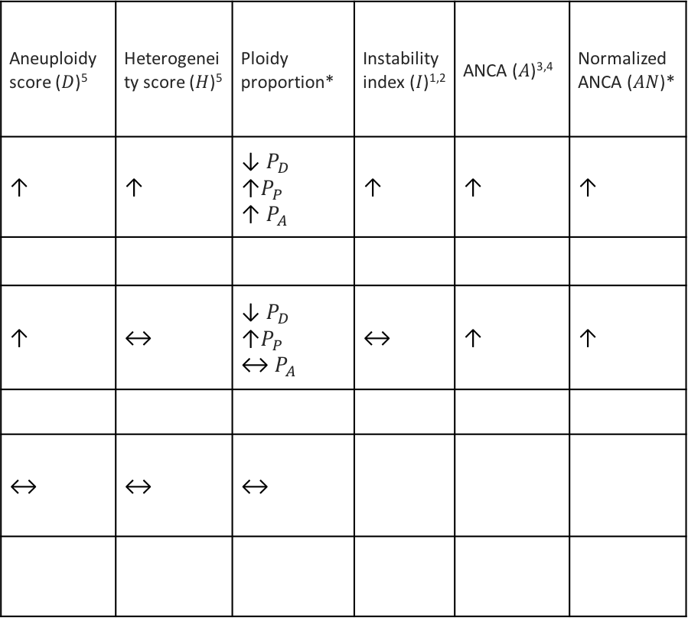
How do the summary scores change in Treatment B relative to Treatment A?
Aneuploidy score ($D$)⁵ | Heterogeneity score ($H$)⁵ | Ploidy proportion* | Instability index ($I$)^{1,2} | ANCA ($A$)^{3,4} | Normalized ANCA ($AN$)*
↑ | ↑ | ↓$P_{D}$ $\text{↑}P_{P}$ $\text{↑} P_{A}$ | ↑ | ↑ | ↑
↑ | ↔ | ↓$P_{D}$ $\text{↑}P_{P}$ $\text{↔} P_{A}$ | ↔ | ↑ | ↑
↔ | ↔ | ↔
Treatment A
Treatment B
1 2 3 4
1 2 3 4

Slide 18
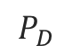
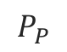
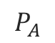
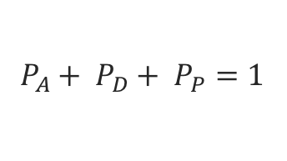
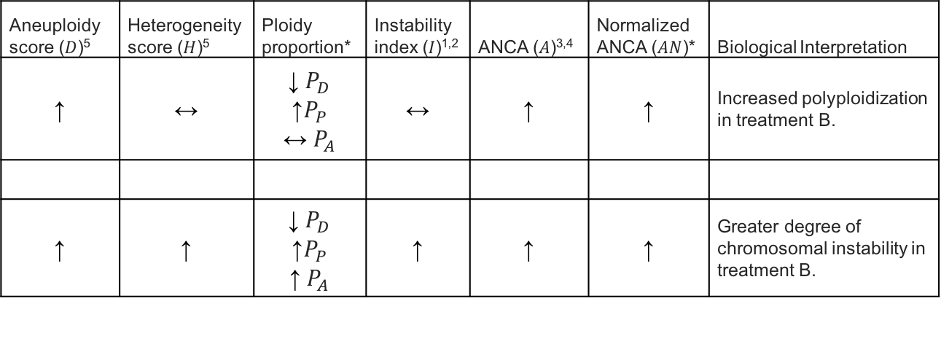
How do the summary statistics change in Treatment B relative to Treatment A?
Treatment A
Treatment B
Aneuploidy score ($D$)⁵ | Heterogeneity score ($H$)⁵ | Ploidy proportion* | Instability index ($I$)^{1,2} | ANCA ($A$)^{3,4} | Normalized ANCA ($AN$)* | Biological Interpretation
↑ | ↔ | ↓$P_{D}$ $$\text{↑}P_{P}$$ $\text{↔} P_{A}$ | ↔ | ↑ | ↑ | Increased polyploidization in treatment B.
↑ | ↑ | ↓$P_{D}$ $\text{↑}P_{P}$ $\text{↑} P_{A}$ | ↑ | ↑ | ↑ | Greater degree of chromosomal instability in treatment B.
Copies of Chr. 17
1 2 3 4
1 2 3 4
Ploidy proportion
Copies of Chr. 12
Classification
1 2 3 4
Darker red = greater proportion of cells in that state
Polyploid
$$P_{P}$$
Chr. 17
1 2 3 4
Chr. 17
Diploid
$$P_{D}$$
1 2 3 4
Aneuploid
$$P_{A}$$
Chr. 12
1 2 3 4
$P_{A}+ P_{D}+ P_{P}=1$
Chr. 12

Slide 19
75% of cells have two copies of chromosomes 12 and 17
 | 75
1 2 3 4
Chr. 17
 | 75
1 2 3 4
1 2 3 4
Chr. 17
Chr. 12
1 2 3 4
Chr. 12
Classification
Polyploid
1 2 3 4
Chr. 17
Diploid
Aneuploid
1 2 3 4
Chr. 12

